Slide 1

PCA PROJECT PROPOSAL
By
The Strawberries
03.02.2025 – :P

Slide 2

Project Ideas
NAMES AND IDEAS | DESCRIPTION
Mariana - Scientific graphic calculator | A Desmos inspired graphing calculator that can do complicated math equations and display the results graphically
Tiba - Atom creator and visualizer | Drag protons, neutrons and electrons to create known or unknown atoms (names displayed)
Natacha - Orbit gravitational simulator | Drag moons into orbit (set gravity, mass, size, etc.) and watch them interact with the planet.
Vassiliki - E&M Circuit designer and simulator | Design an electric circuit using a multitude of electrical components, set resistance and voltage, etc. (With possibility of graphs.)
CHOSEN IDEA: E&M Circuit designer and simulator | This is the most realistically achievable project within our timeframe while maintaining a good level of difficulty and complexity.

Slide 3

The Physics Concept
https://www.falstad.com/circuit/
An electric current is made of components (ex: resistors, transistors, capacitors) connected by wire such that current can flow.
Components are simplified in diagrams.
A direct current happens when the electrons move in one singular direction.
Ohm’s and Kirchhoff's laws: calculate the voltage, resistance, and current through each part of the circuit.
Resistors have a color code (external database)
PROJECT PROPOSAL
CS

Slide 4

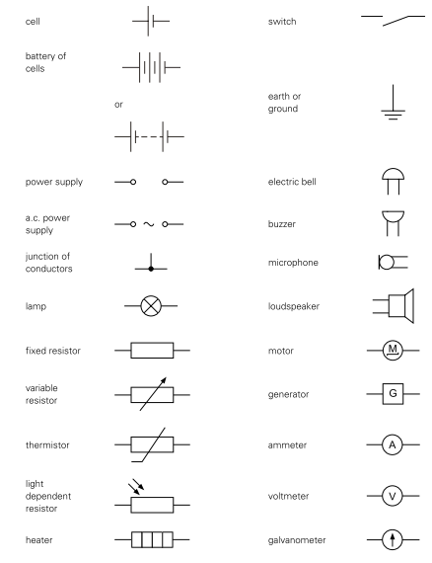
Diagram convention

Slide 5
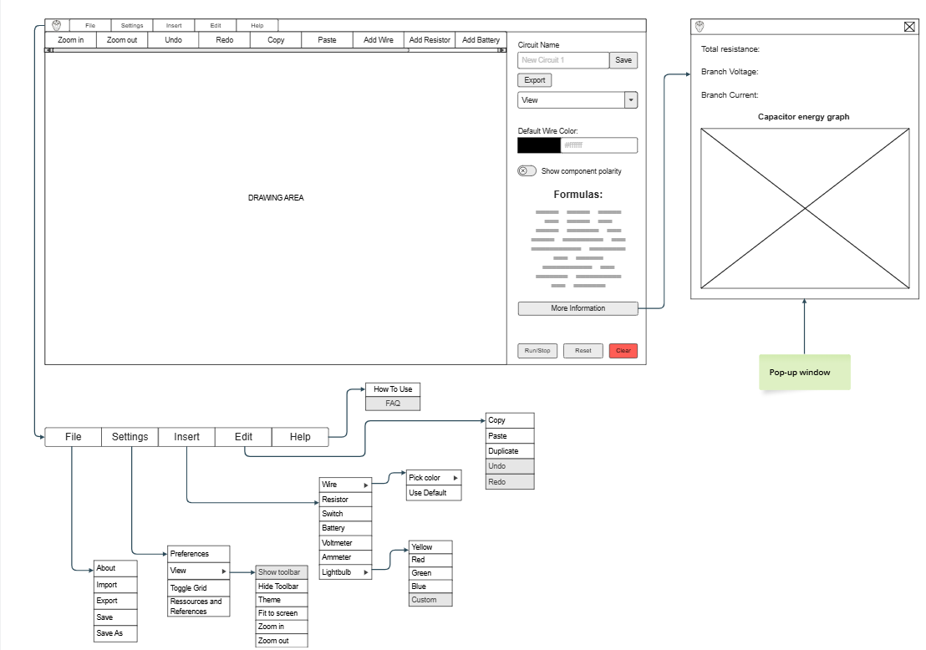
Full Interface

Slide 6
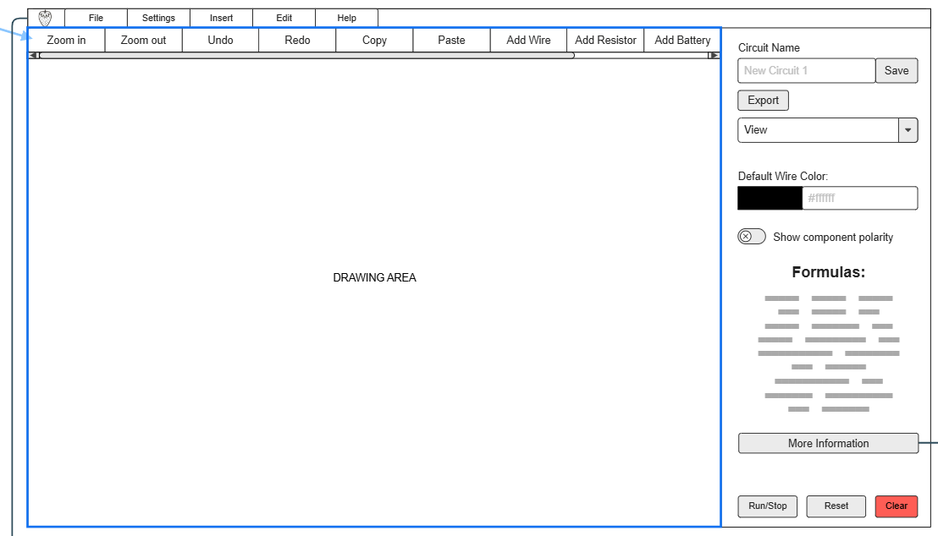
Main Window

Slide 7
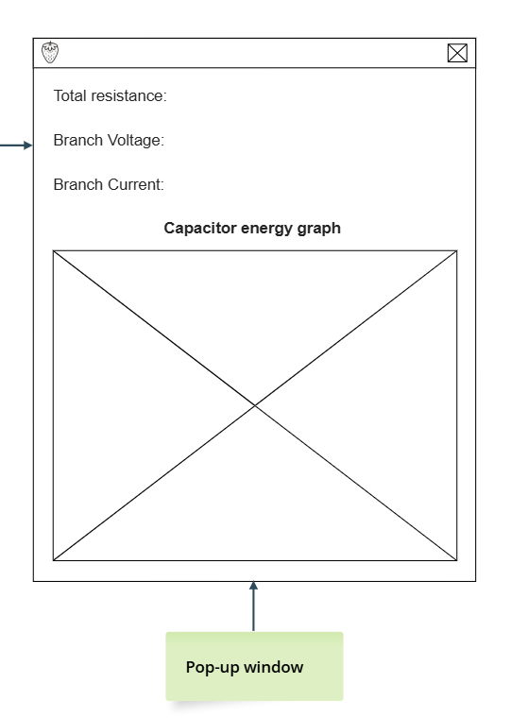
Pop-Up Information Window

Slide 8
The Concept Aspects
Problems:
Electricity is quite abstract and hard to visualize
Tools online usually lack in real time data
Circuits are limited in design
Solutions:
Create an intuitive electrical circuit simulator that allows students to visualize and understand circuits.
Create a real-time graph that simulates the different components of a circuit
Allow users to create their own circuit and modify the different components and parameters.
PROJECT PROPOSAL
CS

Slide 9

Input and Output
INPUT
The user designs a personalized electrical circuit using a set of predetermined components.
User can change the value of the different components (i.e. the battery voltage).
They can choose to toggle visual extras (graphs, a grid, drawings VS images, and more).
“Export” option.
OUTPUT
The circuit is animated by showing the movement of electrons through the wire.
Shows the different values - voltage, current, and energy- throughout the circuit.
Visual elements (ex.: background, drawings, theme) can be modified for a better visual experience.
Pop-up windows are created to show graphs and relevant data.
The user can save an image of their circuit to their files.
PROJECT PROPOSAL
CS

Slide 10
Team Contributions
MARIANA
Drag & draw logic, implement linked list, export, undo/redo, more advanced components
TIBA
Toolbar, zoom in/out, graphs for capacitors, implement battery and resistors
VASSILIKI
Implement logic behind circuit (polarity, current, voltage), copy/paste, short circuits
NATACHA
UI, UX, optimisation, data collection for total resistance/voltage/current
PROJECT PROPOSAL
CS

Slide 11

Feasibility
Task | Estimated time
UI and adding all the electrical components | 3 weeks
Implementing circuit (connecting components, calculating volts, circuit building) | 4-5 weeks
Edit/delete/copy/paste/undo/redo | 3-4 weeks
Export/saving | 2 weeks
optimization/extra | 2 weeks
PROJECT PROPOSAL
CS

Slide 12
JavaFX Elements
Libraries:
(Maybe) java.nio -> for exporting/downloading files
Json
JavaFX elements:
BorderPane for the main window
UI elements such as buttons, labels, menus, toggles, imageView, etc
AnimationTimer
Event Handling (mouse events)
Javafx.chart for the graphs
PROJECT PROPOSAL
CS

Slide 13


THANK
YOU

